Slide 1
Available boot options
CD/DVD
Bootable USB
PXE network boot
Advantages of network boot over other boot options
  Easy to customize
  Scales better

Slide 2
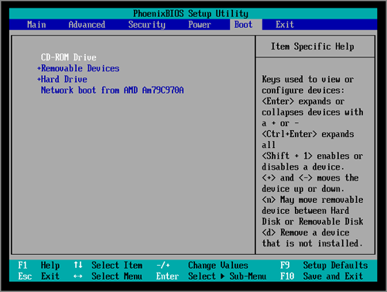

Slide 3
PXE Boot
The Preboot Execution Environment (PXE)- can be configured and booted remotely by admin
Requirements: Boot server, DHCP server and a client
The PXE Boot process is as follows.
  Calls the DHCP server
  Gets the IP address and the NBP
  Downloads the NBP in client and launches
Two ways to get the NBP file
  IP helper tables
  DHCP option

Slide 4
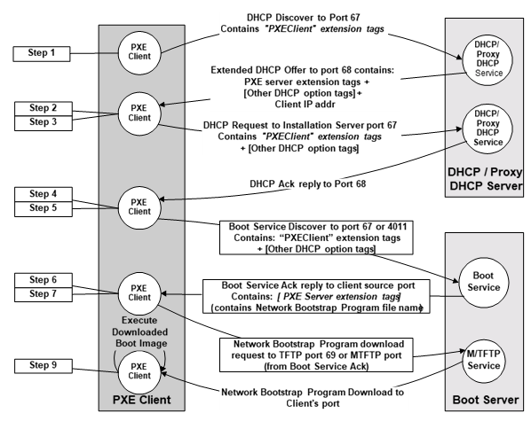

Slide 5
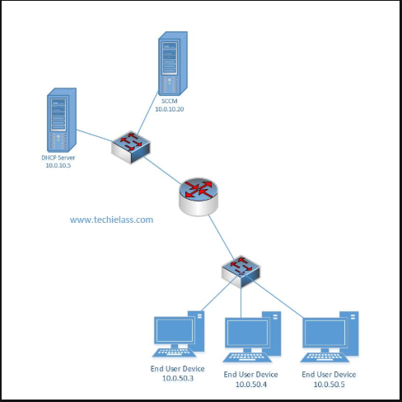

Slide 6
Disadvantages of DHCP options
Clients incorrectly passing DHCP options
Multiple network boot servers- prevents load balancing
Might be directed to an unavailable boot server
Bypass the network boot servers answer settings

Slide 7
References
https://www.manishbangia.com/ip-helper-address-configuration-for-pxe-boot/
https://www.techielass.com/dhcp-and-the-pxe-boot-process-explained
https://www.howtogeek.com/57601/what-is-network-booting-pxe-and-how-can-you-use-it/
https://techthoughts.info/pxe-booting-wds-dhcp-scope-vs-ip-helpers/
https://systemscenter.ru/wds_deploymentguide.en/html/c169579c-c0fc-4ec6-aa8d-0af5504fda01.htm
https://networkboot.org/fundamentals/
https://wiki.fogproject.org/wiki/index.php?title=Booting_into_FOG_and_Capturing_your_first_Image#PXE_booting

